Slide 1
TRANSPARENT KEYBOARD
Venkata Pavan Rama Sai Bharadwaj. Gorthy
Yasith Mir
Department of Electrical and Computer Engineering
Colorado State University

Slide 2
Introduction:
Why a Transparent keyboard?

Slide 3
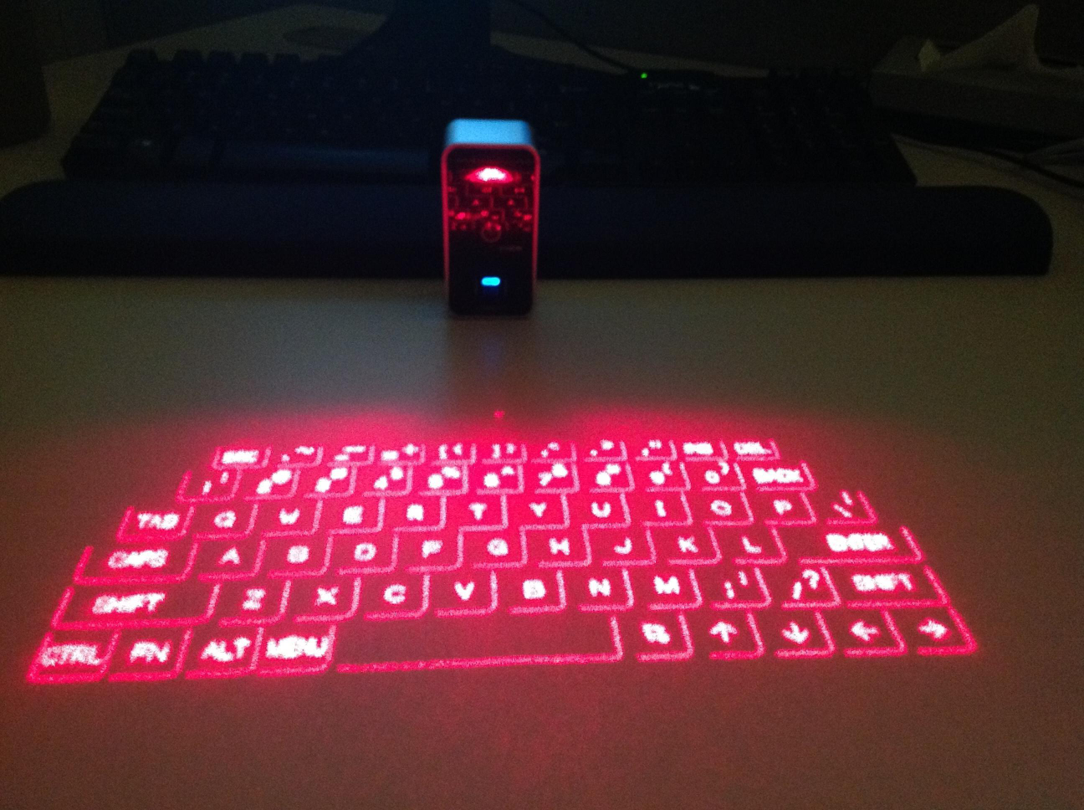
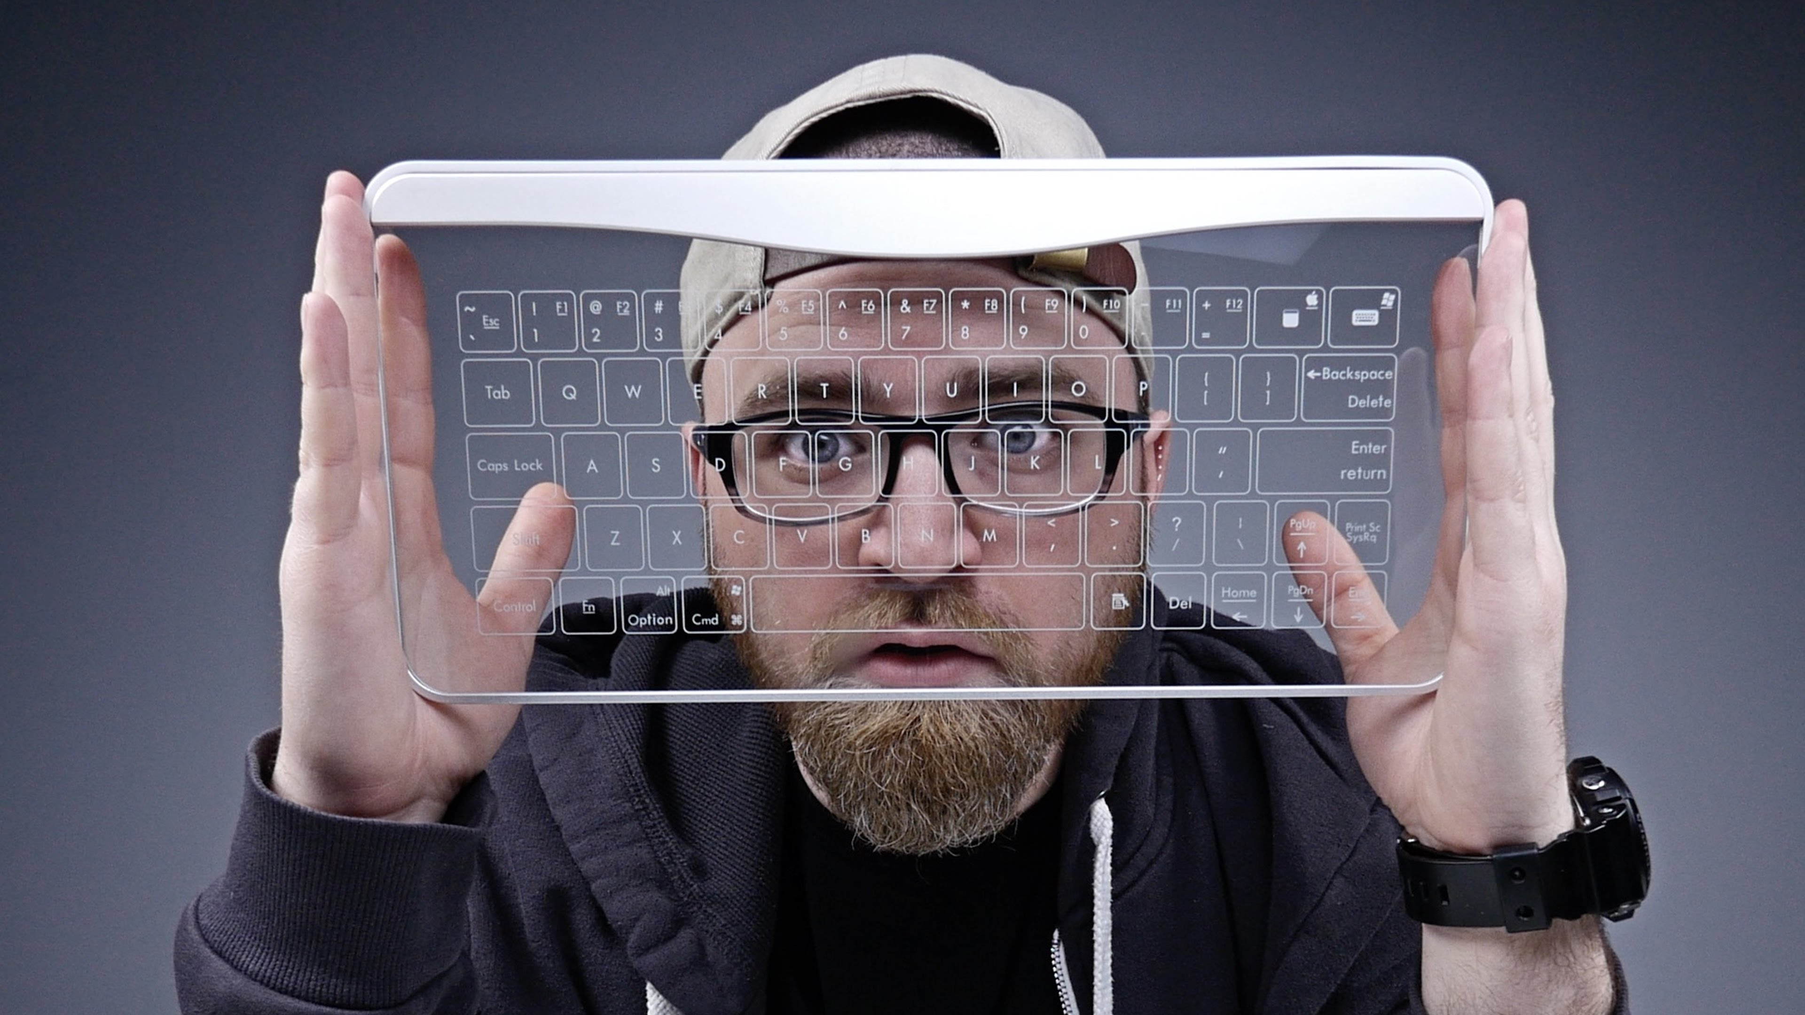
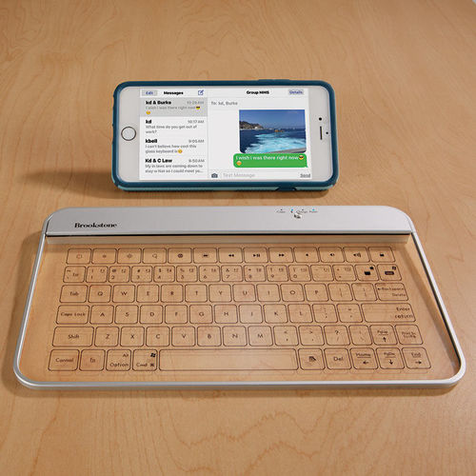
Earlier Models:
Laser Projection Keyboards
Bastron Glass Keyboard
Brookstone Glass Keyboard

Slide 4
Proposed Design:
Based on InfraRed
Emitters and Sensors arranged on the periphery
Emitters and Sensors connected to Teensy board
USB capabilities
Initial frame matrix size: 12x4
Achieved 7x4 matrix with 28 inputs
54 alphanumeric symbols

Slide 5
Prototype Design Components:
Teensy 3.6 and not Raspberry Pi ?
Super bright 5mm 940nm IR LED Emitter
TSOP38238 IR Receiver Sensor

Slide 6
Prototype Working:
IR Emitters and Receivers are arranged on the sides of the rectangular frame
IR Emitters are given a pulse of 38KHz signal
IR Receiver Sensors tuned to this frequency to detect the emitting IR light
When beam is interrupted or a break in IR beam, sensor detects a positive edge change which triggers the key press
The Teensy Keyboard has a Library which allows keyboard inputs via USB

Slide 7
Working (contd..):

Slide 8
Demonstration:
Demo:https://youtu.be/RWafu48EANk
Slide-cast link: https://youtu.be/WeoqTixa24E
Random key press link: https://youtu.be/WM94BCVWMWc

Slide 9
Improvements and Future work:
Sending encoded signals rather than a single 38KHz pulse from all the emitters
Ensuring that the horizontal and Vertical beams are not in the same plane
Proposed frame material was glass/fiber/acrylic but because of reflections and poor insulation, thin Balsa wood was preferred
A thin coating of Tin Oxide on the glass frame
Implement Combo key press functionality

Slide 10
Conclusion:
Prototype keyboard costed around $61.25
When mass produced, the cost reduces further
Beats Bastron and Brookstone Keyboards in price and stands close to that of Projection keyboard

Slide 11
Thank You

